Slide 1
CMPE 202- Software Systems Engineering Team Project Presentation
Rent-A-Car
(UI Screenshots)
By
Geethu Padachery
Monica Dommaraju
Shree Gowri Radhakrishna
Sri Sruthi Chilukuri

Slide 2
UI Screens for the “Admin” Role of the Application

Slide 3
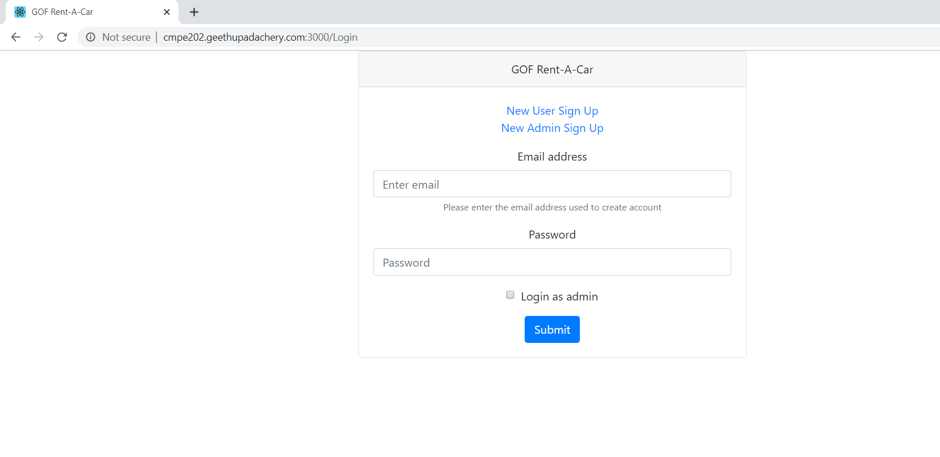
Login

Slide 4
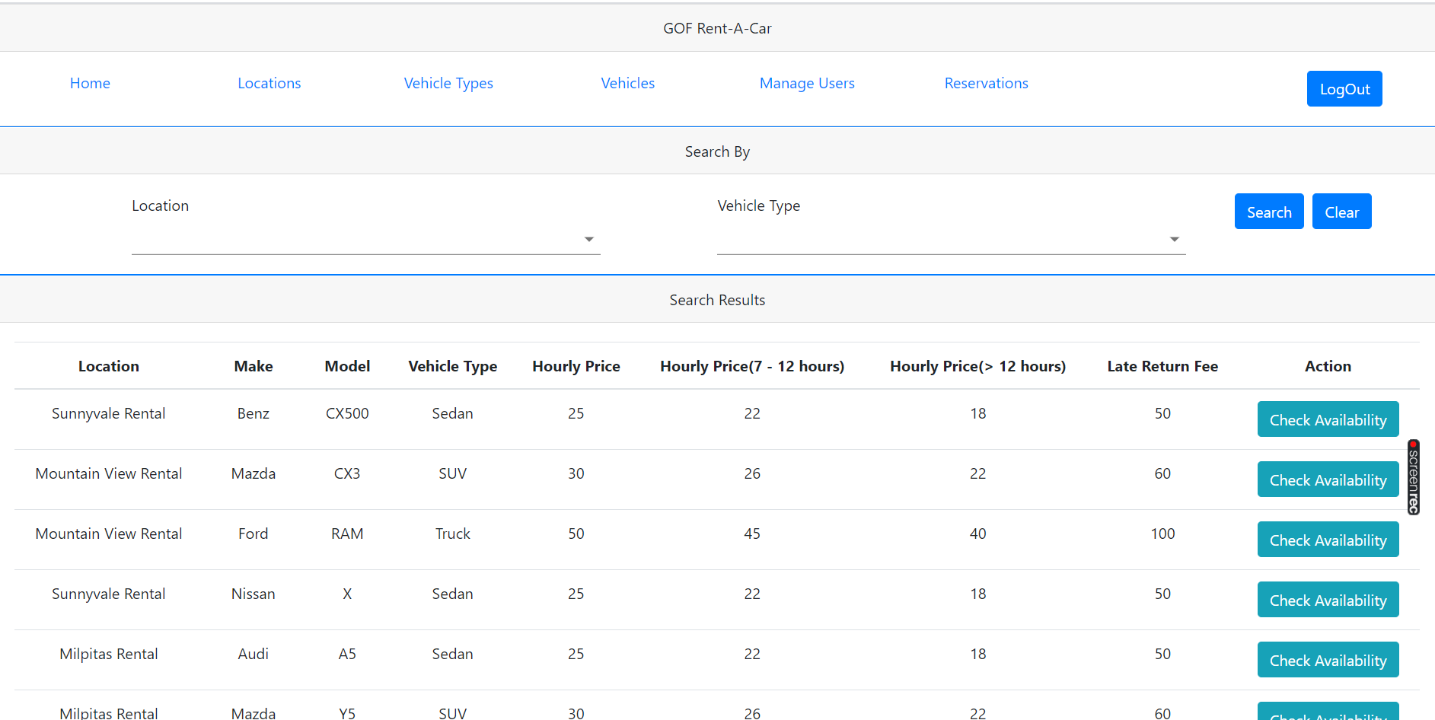
Home

Slide 5
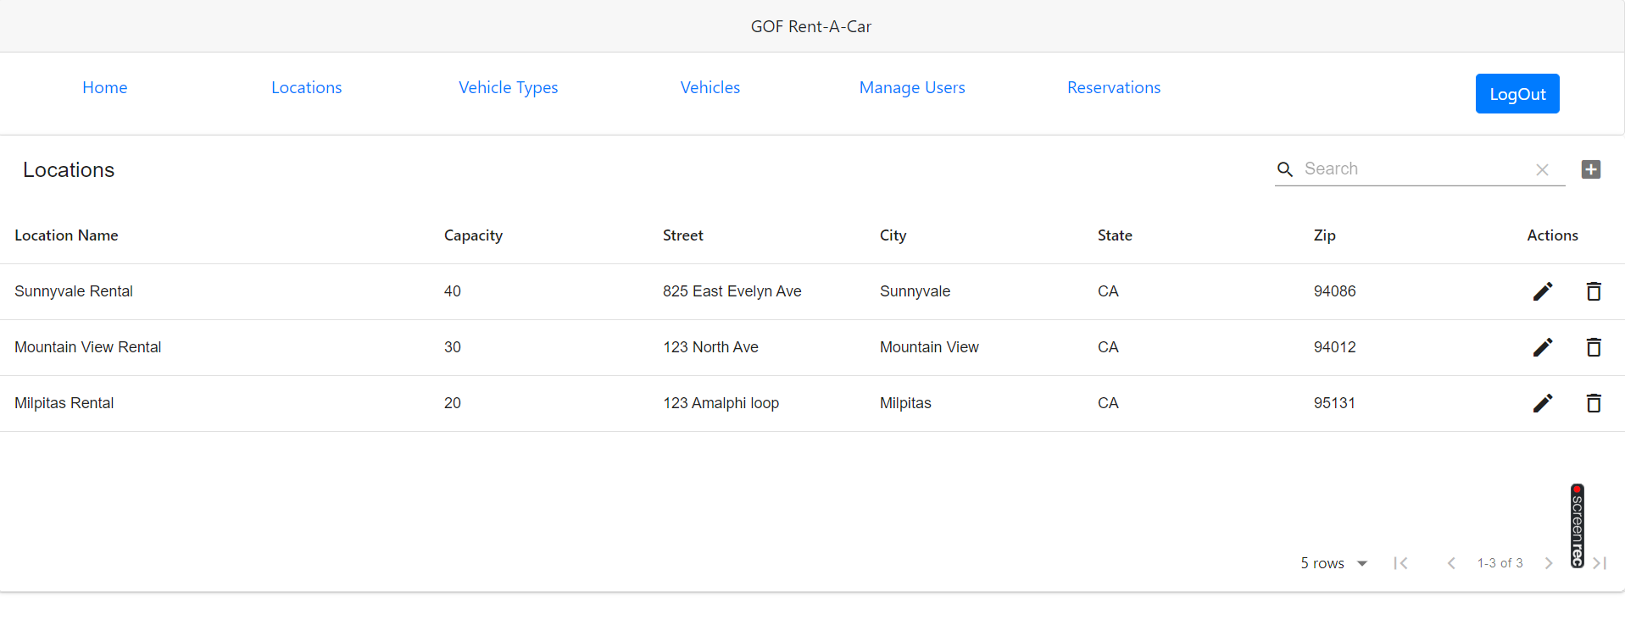
Location

Slide 6
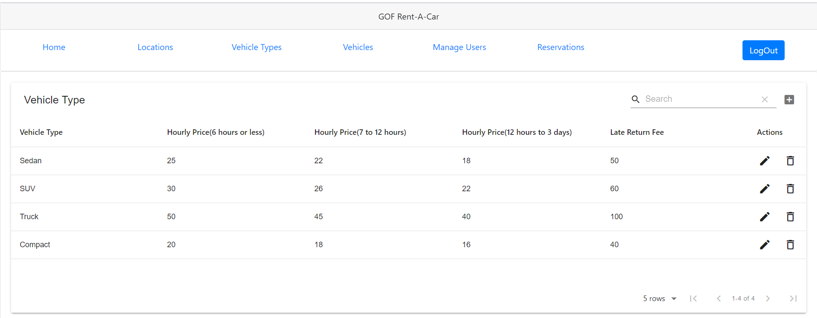
Vehicle Type

Slide 7
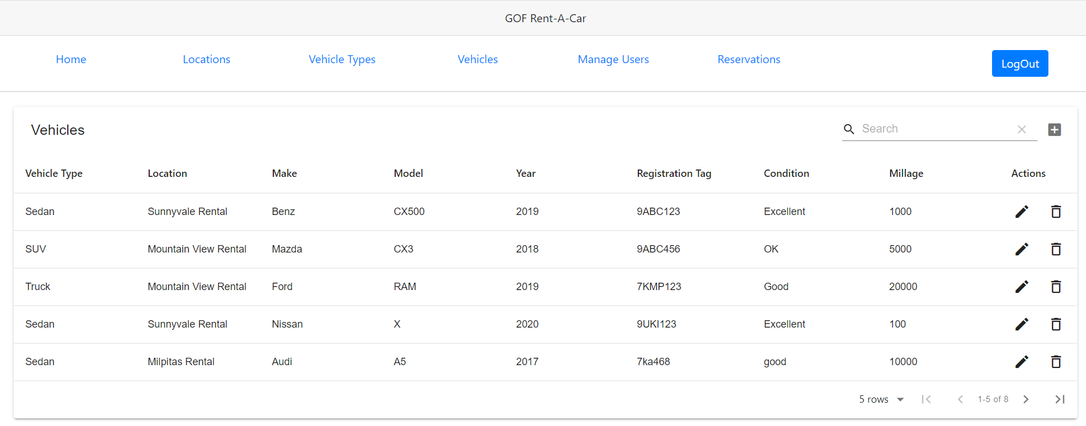
Vehicle

Slide 8
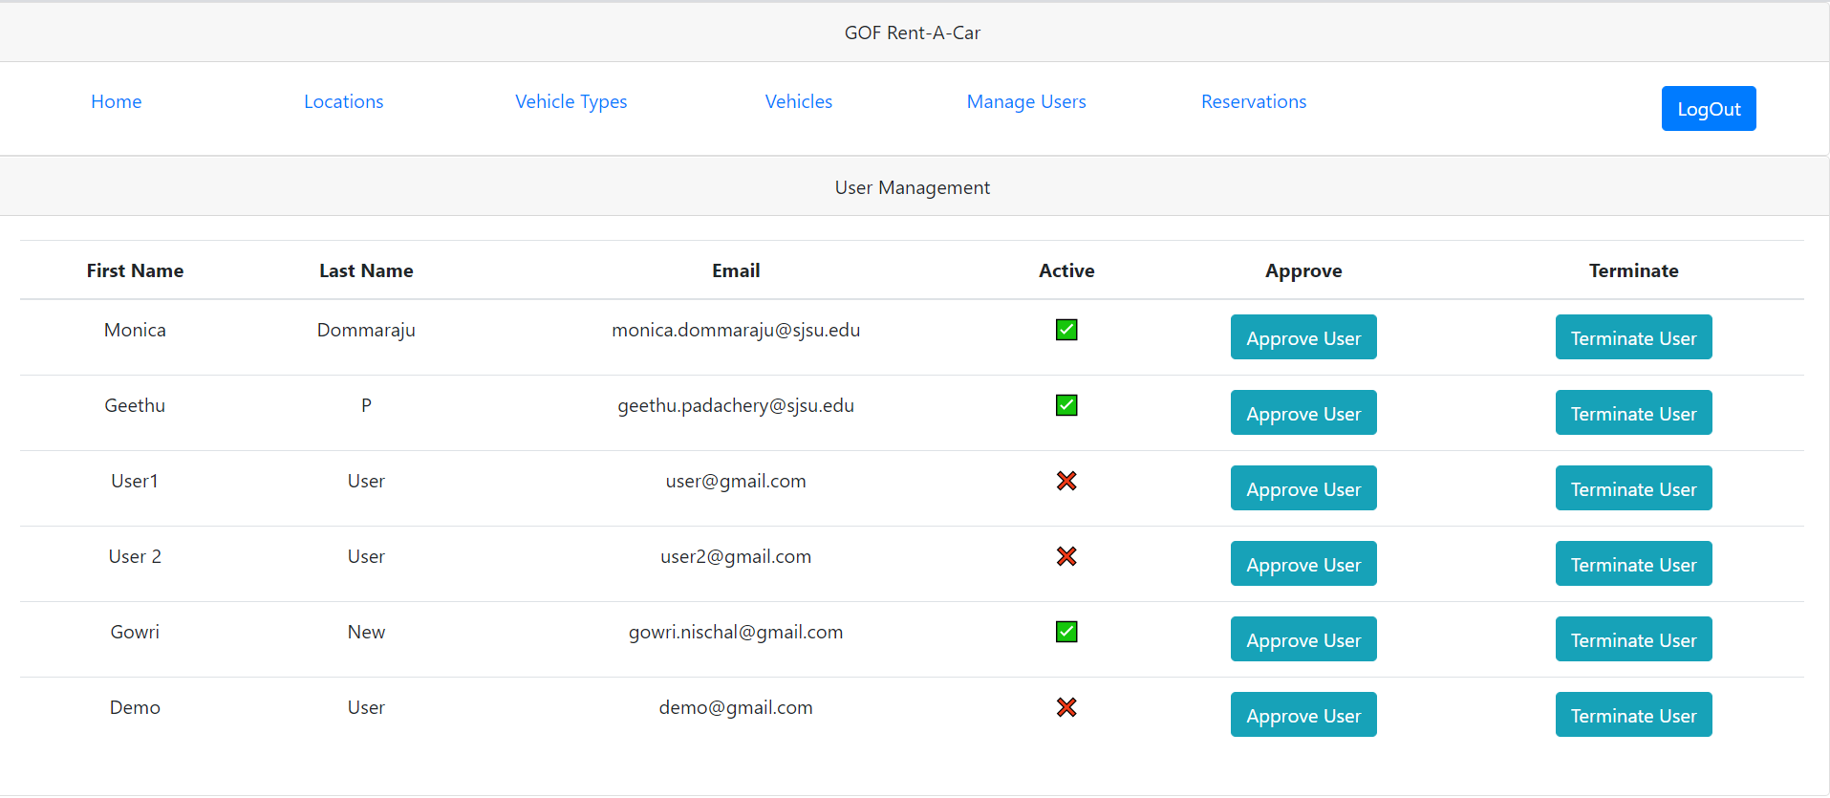
Manage Users

Slide 9
UI Screens for the “User” Role of the Application

Slide 10
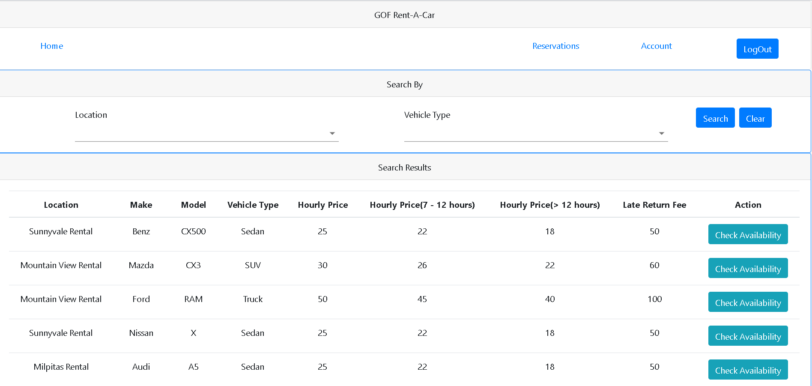
Users Home screen

Slide 11
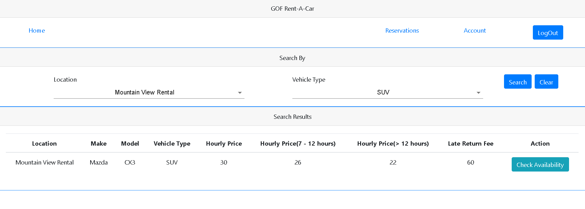
Search Mechanism for User: To find Vehicle by “Location” & To find Vehicle by “Vehicle Type”

Slide 12
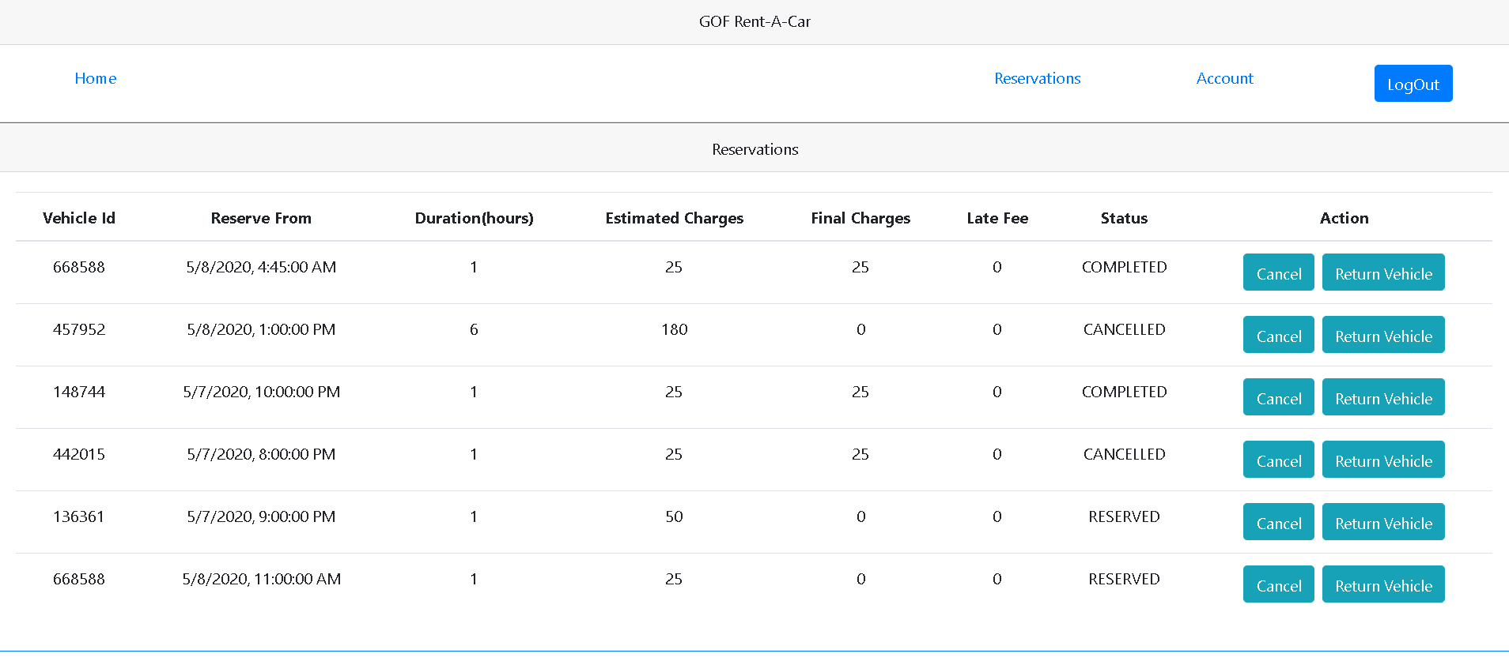
User’s Reservations Tab

Slide 13
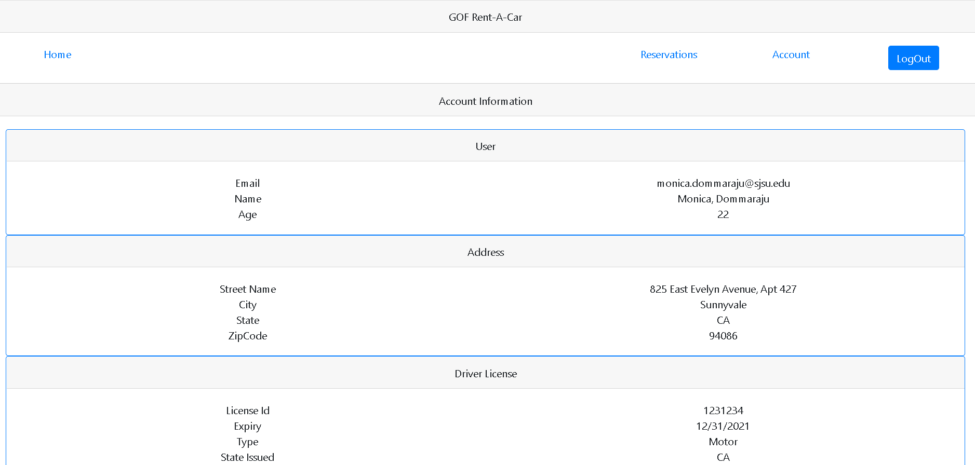
User’s Account displaying his/her personal details

Slide 14
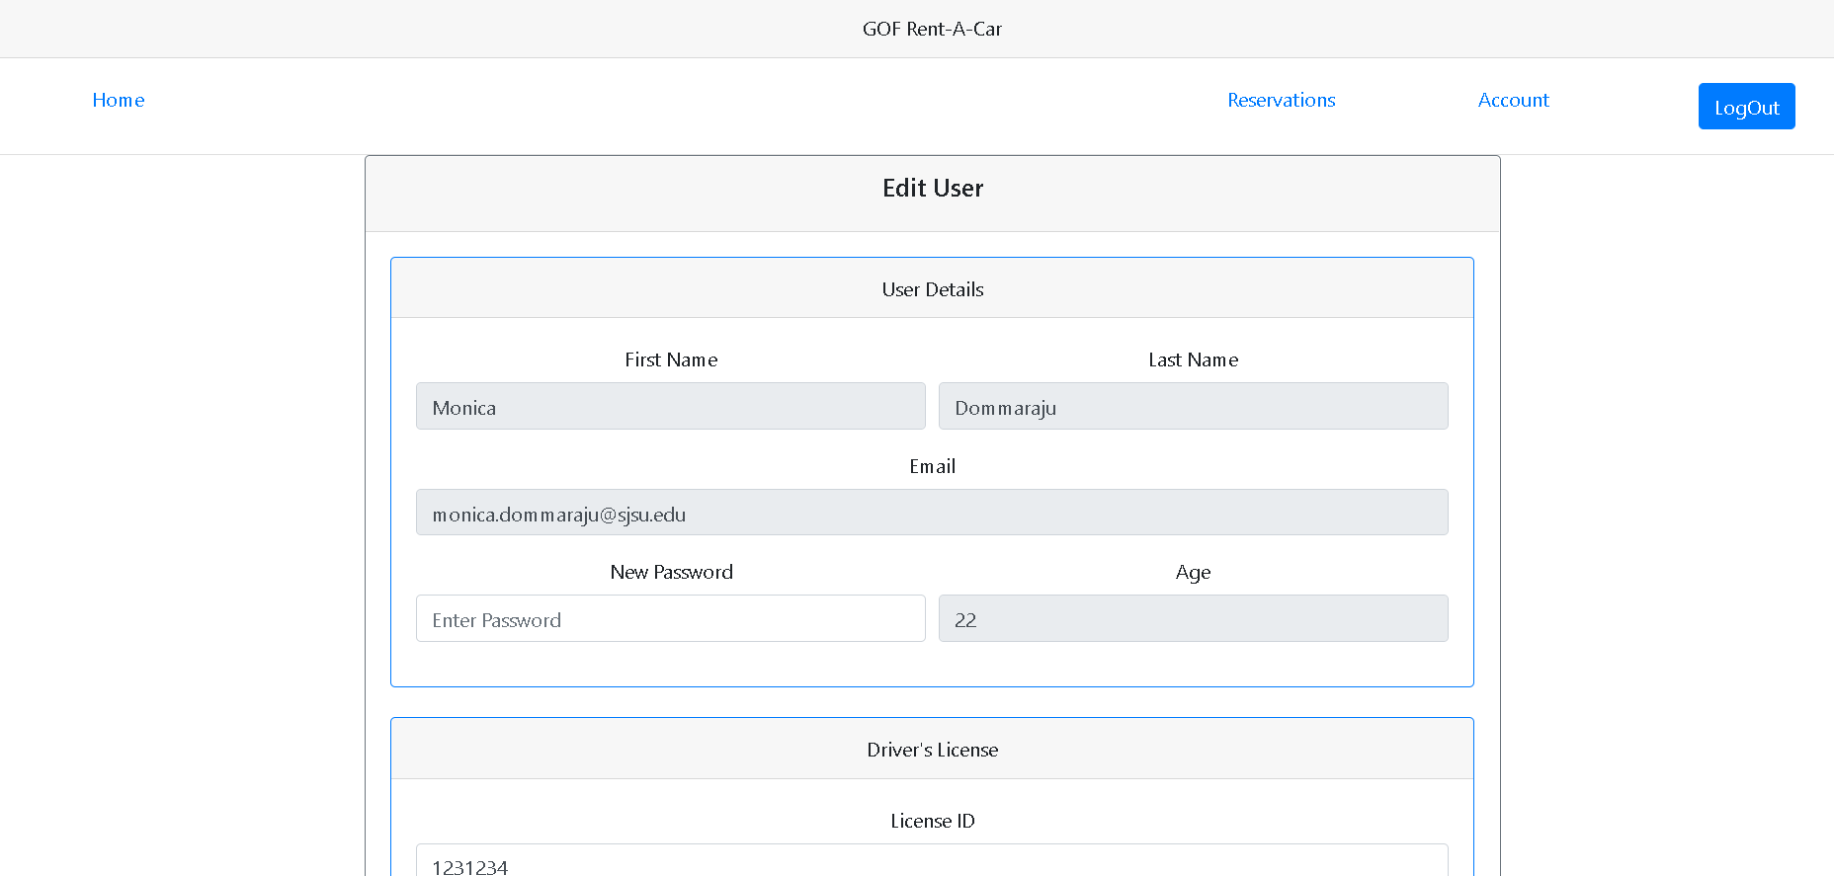
Editing User details Screen

